Slide 1
California Energy Demand 2016-2026 Revised Electricity Forecast: San Diego Gas & Electric Planning Area
December 17, 2015
Cary Garcia
Demand Analysis Office
Cary.Garcia@energy.ca.gov

Slide 2
Forecast Summary
No change to planning area definition
Drop in electricity consumption compared to CEDU 2014 partially offset by more than proportionate growth in EVs
Sales and peak down more significantly because of higher PV

Slide 3
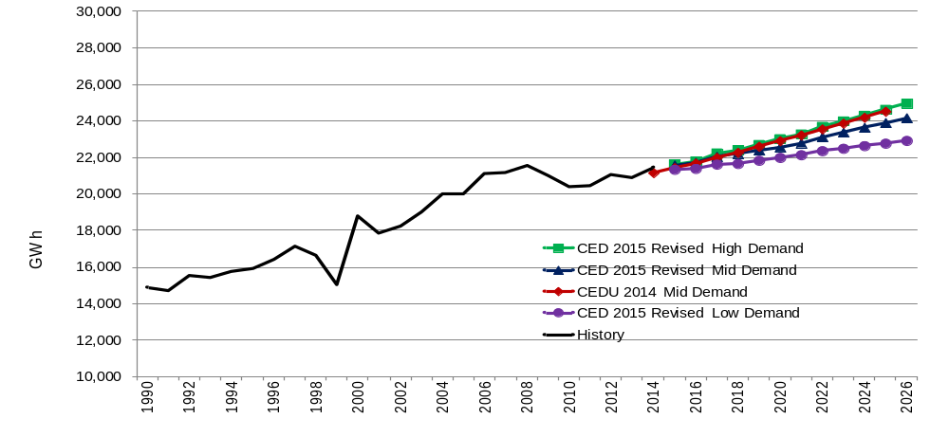
SDG&E Baseline Electricity Consumption
New high demand case matches CEDU 2014 mid case

Slide 4
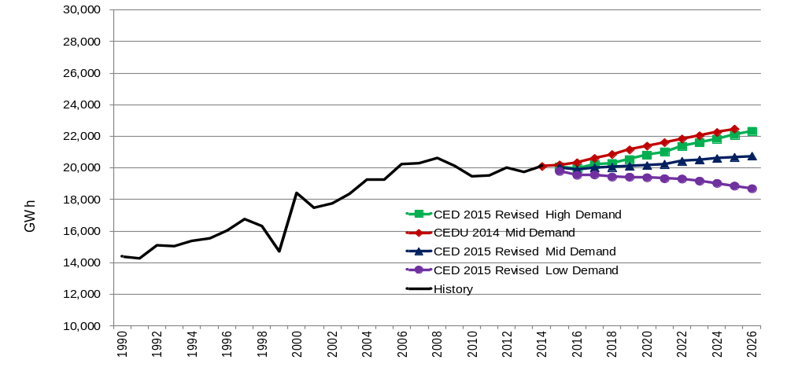
SDG&E Baseline Electricity Sales
New mid case grows at 0.25% per year (2014-2025) compared to 1.03% for CEDU 2014 mid case

Slide 5
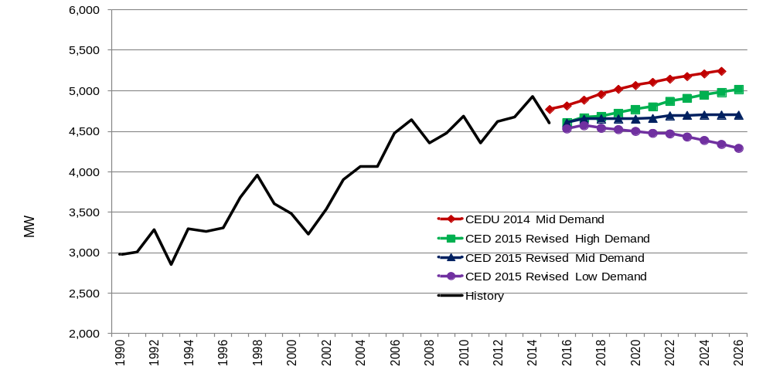
SDG&E Baseline Peak Demand
Flat growth in new mid case; more than 500 MW below CEDU 2014 mid case by 2025

Slide 6
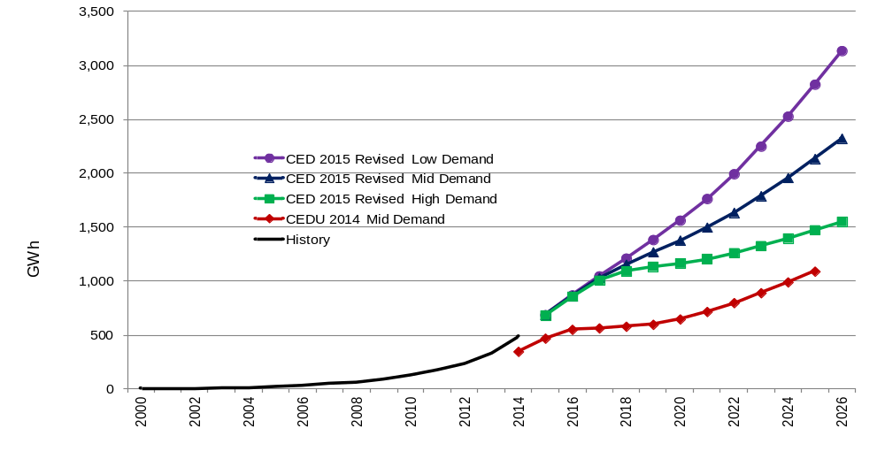
SDG&E PV Energy
Almost all of the increase comes from residential

Slide 7
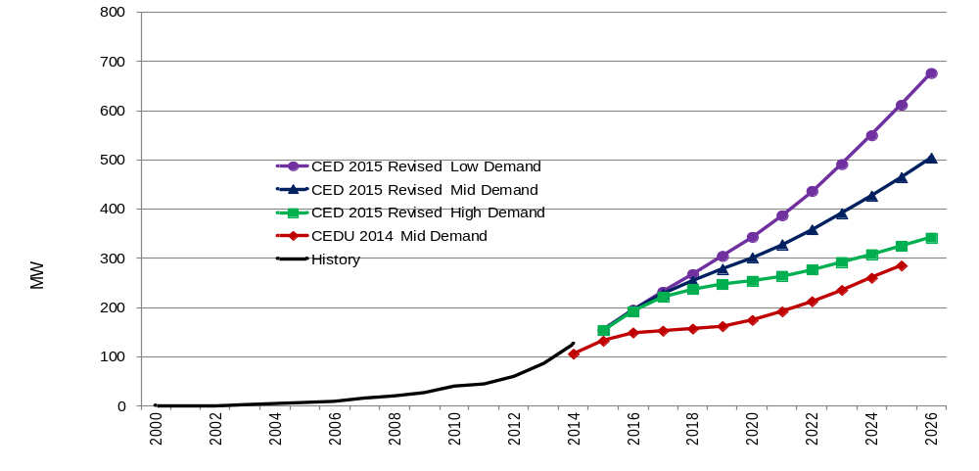
SDG&E PV Peak Impacts
CED 2015 Revised mid case corresponds to around 1,300 MW capacity in 2026

Slide 8
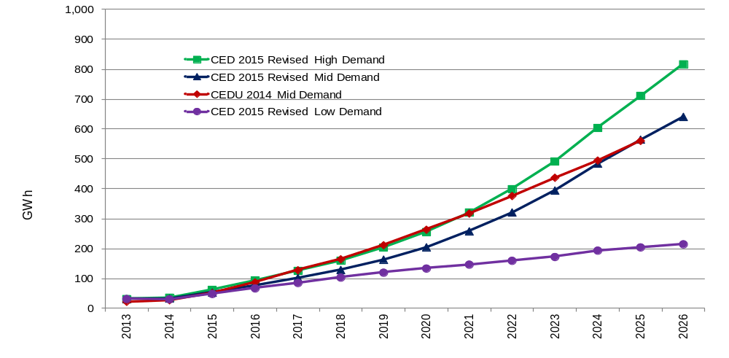
SDG&E Light-Duty EV Energy
Corresponds to around 250,000 EVs in 2026 in the mid case

Slide 9
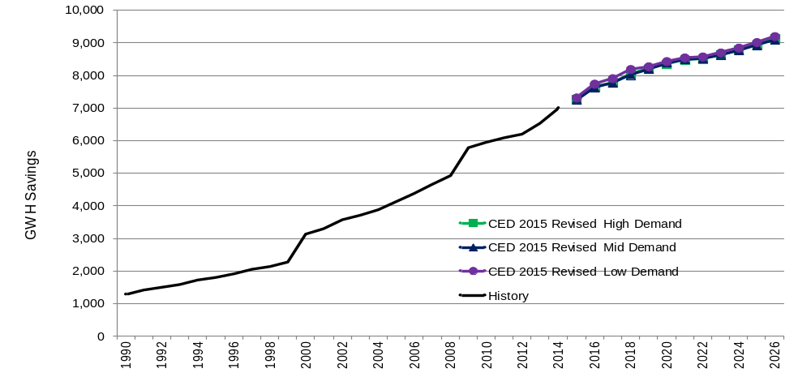
SDG&E Committed Efficiency
Around 4,000 GWh savings from codes and standards in 2014

Slide 10
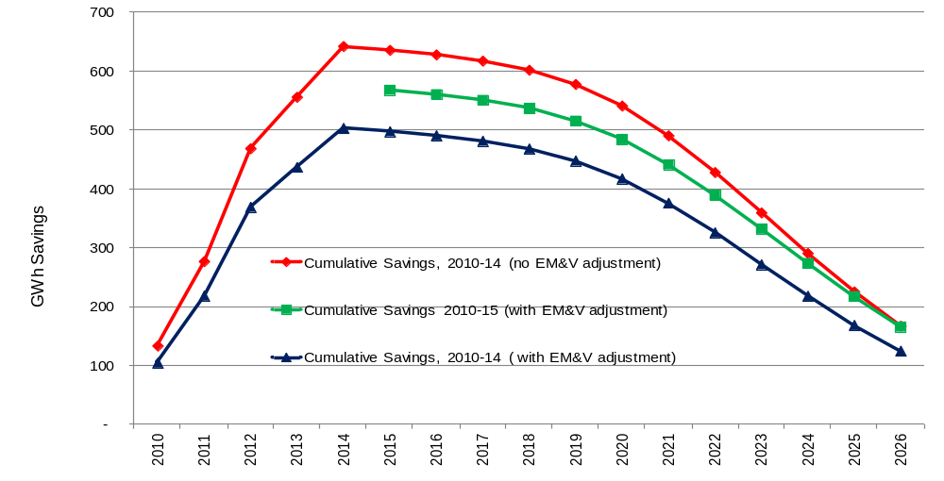
Efficiency Programs: EM&V Adjustment
Net effect: -68 GWh in 2015, -2 GWh in 2026

Slide 11
Additional Impacts
Climate change
  70 GWh in 2026 in mid case, 45 GWh in high case
  20 MW in 2026 in mid case, 40 MW in high case
Electrification: 40 GWh in 2026 in mid case, 80 GWh in high case
60 MW of demand-side DR in 2026

Slide 12
AAEE Savings: Peak MW
Year | High-Low | Mid-Low | Mid-Mid | Mid-High | High-Low
2016 | 43 | 44 | 51 | 57 | 57
2020 | 164 | 168 | 216 | 242 | 247
2026 | 340 | 344 | 451 | 520 | 532

Slide 13
AAEE Savings: GWh
Year | High-Low | Mid-Low | Mid-Mid | Mid-High | High-Low
2016 | 193 | 192 | 208 | 245 | 251
2020 | 727 | 730 | 953 | 1,125 | 1,137
2026 | 1,412 | 1,413 | 1,903 | 2,220 | 2,228

Slide 14
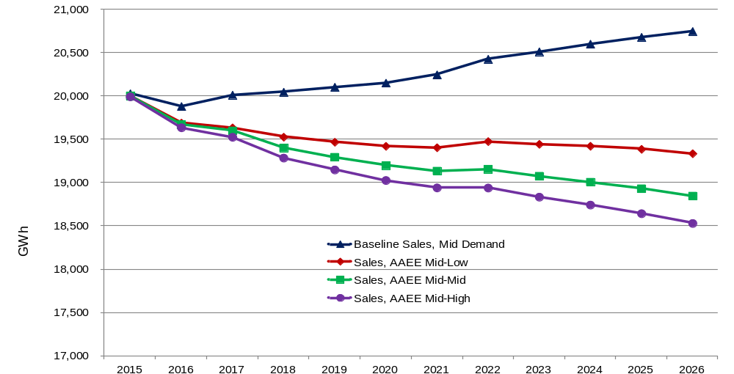
Impact of AAEE on SDG&E Baseline Mid Case Sales, 3 AAEE cases

Slide 15
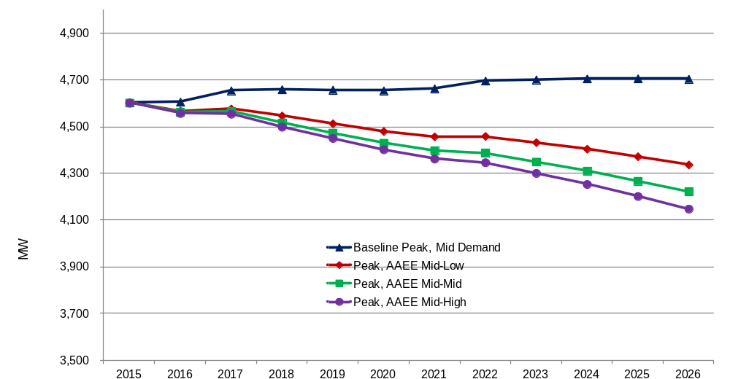
Impact of AAEE on SDG&E Baseline Mid Case Peak, 3 AAEE cases

